Slide 1

CMPE 343
-
Project
-
Presentation
UNIVERSITY DATABASE MANAGEMENT SYSTEM
22314700
MERT YORULMAZ
22207663
UMUT SEVİNÇ
22207964
FURKAN UZUN
22205579
TAHİR DEMİR

Slide 2
Projecti Members and Contributions:
INTRODUCTION
TAHİR DEMİR : Created the Report Slide
The University Database Management System is used to store and organize information about a university. It keeps data about students, teachers, courses, departments, classrooms, sections, and schedules.
Each table in the database has a different job. The Student table stores student information such as name, department, and GPA. The Course table keeps information about courses and credits. The Department table stores department details. The Instructor table includes teacher names and salaries. The Classroom table shows the classrooms and their capacity.
The Section table connects instructors with classrooms and days. The Schedules table shows which student takes which course, who teaches it, and when it starts and ends.
This system helps the university keep information in one place, makes data easy to find, and reduces mistakes.
UMUT SEVİNÇ : Wrote the DDL and Prepared the DML statements.
FURKAN UZUN : Wrote the SQL queries.
MERT YORULMAZ : Designed the ER Diagram.
01

Slide 3
ER DIAGRAM
STRUCTURE
Course : The Course table stores information about courses, such as course name and credit.
Department : The Department table keeps information about university departments and their budget.
This ER Diagram represents a database schema for University Database System.
Section : The Section table connects instructors with classrooms and shows on which day the class is held.
Student : Stores students information, including Student ID, Course ID, Department ID, Name, Surname, CGPA.
Classroom : The Classroom table shows classroom codes and how many students they can hold.
Instructor : Stores instructors information, including Instructor ID, Name, Surname, Salary.
02
Schedules : Schedules table shows which student takes which course, who teaches it, and the start and end dates of the semester.

Slide 4
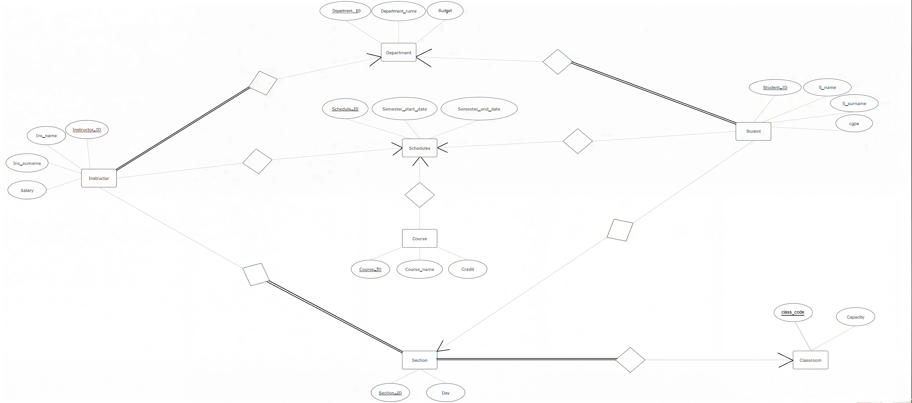
ER DIAGRAM
03

Slide 5
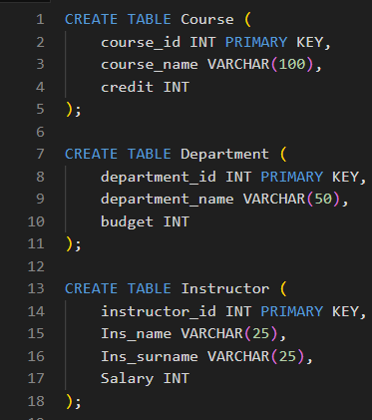
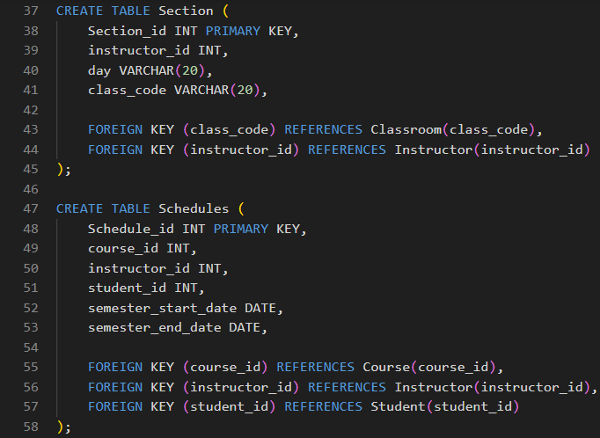
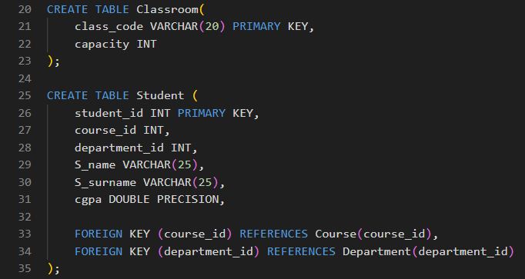
04
DATA DEFINITION LANGUAGE (DDL)
DDL : It is used to create and change tables in a database. With DDL, we can create a table, change a table, or delete a table. Example DDL commands are CREATE, ALTER, and DROP.

Slide 6
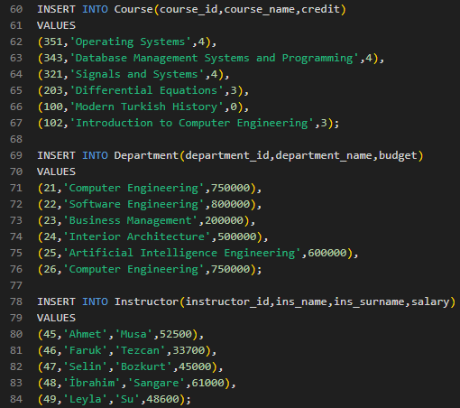
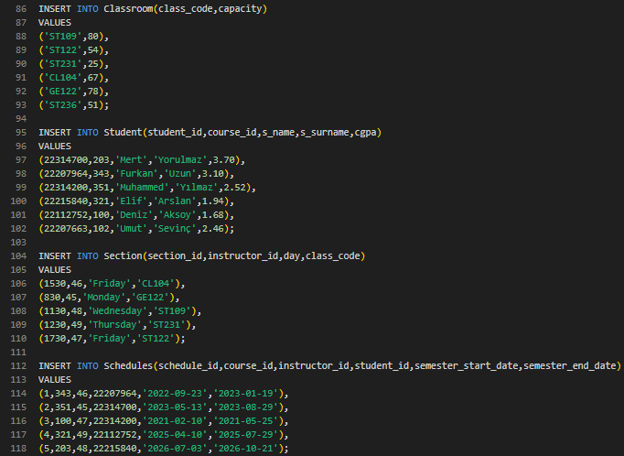
05
DATA MANIPULATION LANGUAGE (DML)
DML : It is used to work with data in tables. With DML, we can add, update, or delete data in a database. Example DML commands are INSERT, UPDATE, and DELETE.

Slide 7
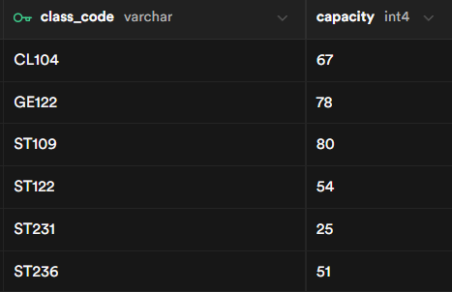
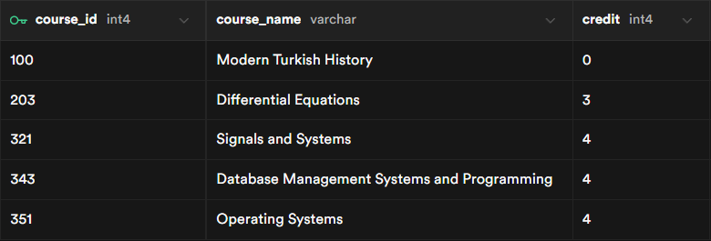
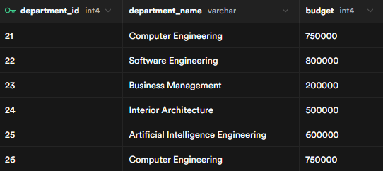
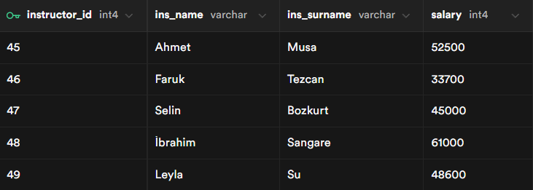
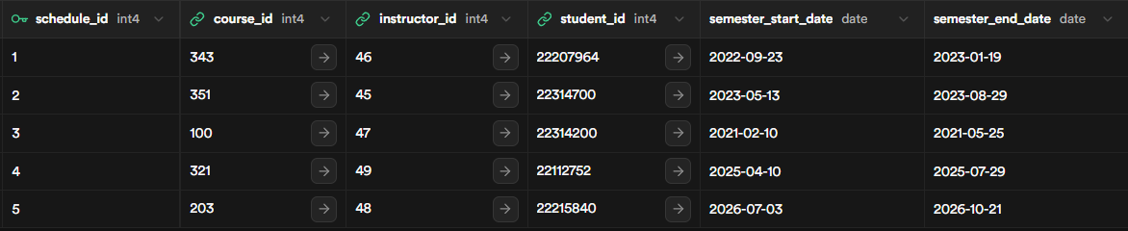
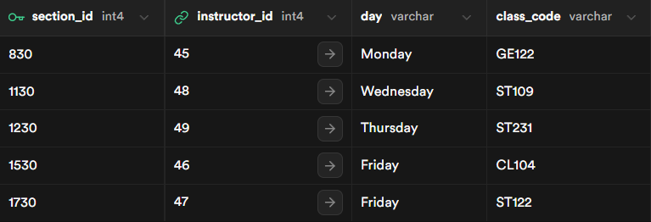
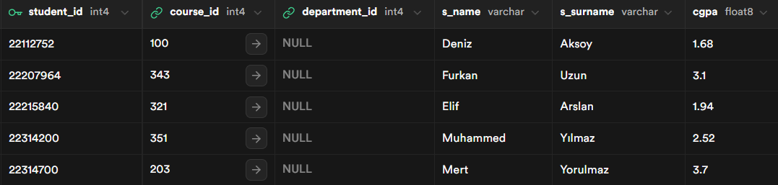
06
DML TABLE RESULTS
Classroom Table Result
Course Table Result
Department Table Result
Instructor Table Result
Schedules Table Result
Section Table Result
Student Table Result

Slide 8
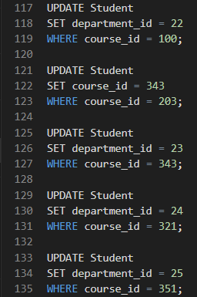
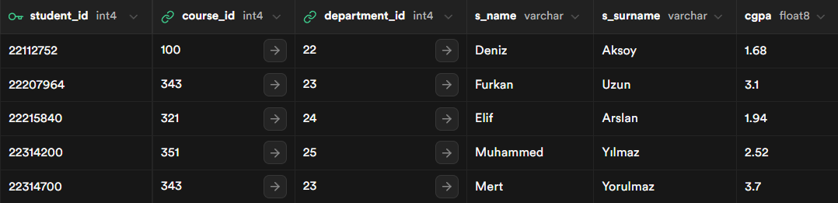
07
DML TABLE RESULTS
(UPDATE)
BEFORE UPDATE DML
UPDATE DML CODE
AFTER UPDATE DML

Slide 9
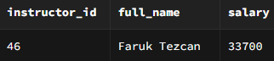

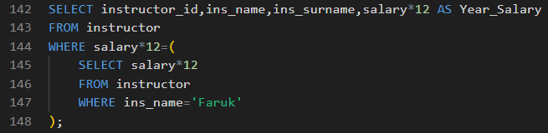
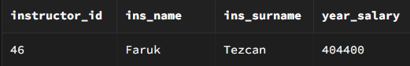
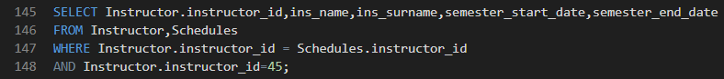
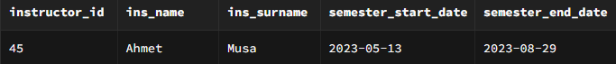
SQL
QUERIES
08

Slide 10
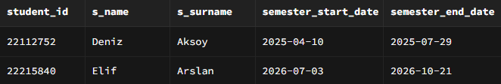
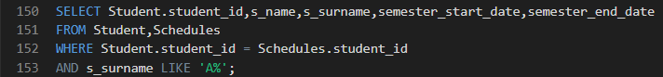
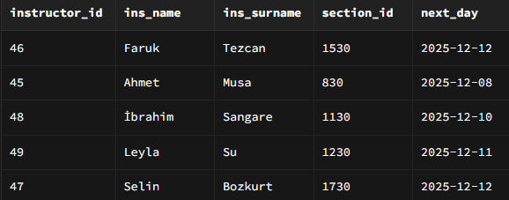
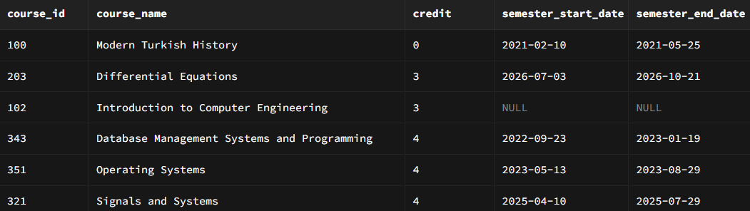
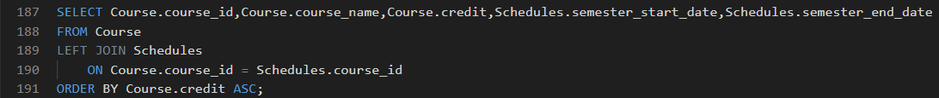
SQL
QUERIES
09

Slide 11
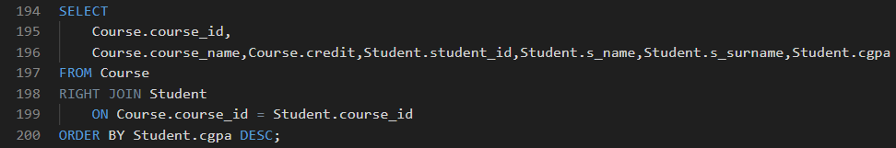
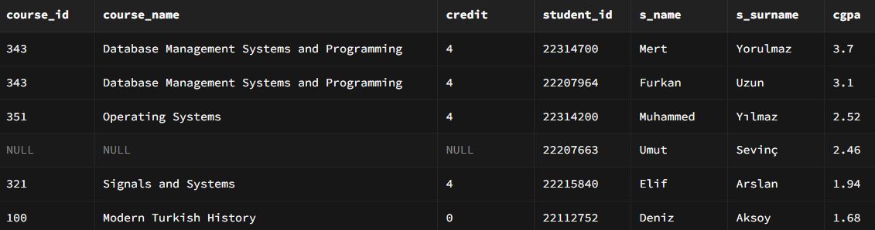
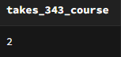
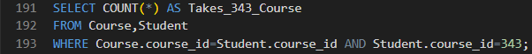
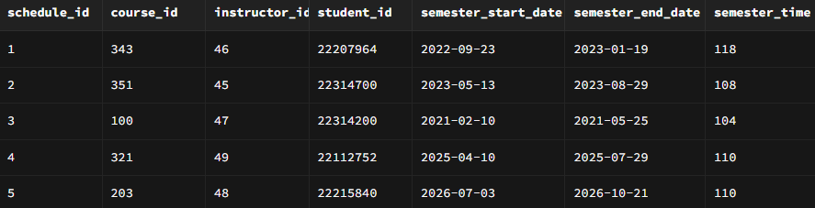
SQL
QUERIES
10

Slide 12
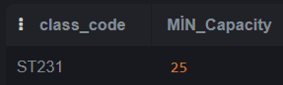
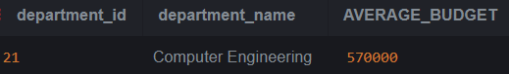
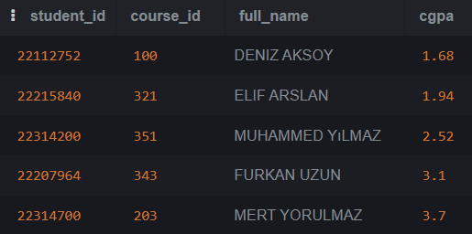
SQL
QUERIES
11

Slide 13
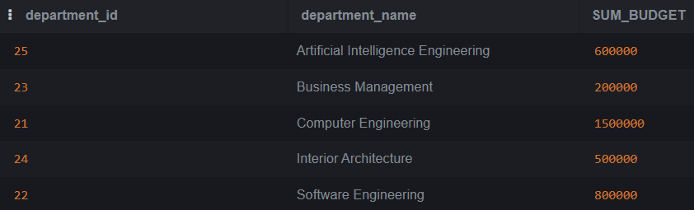
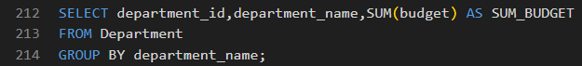
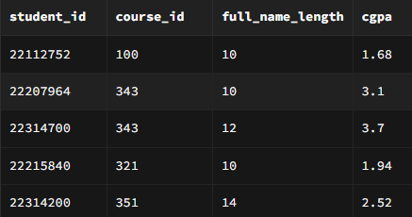
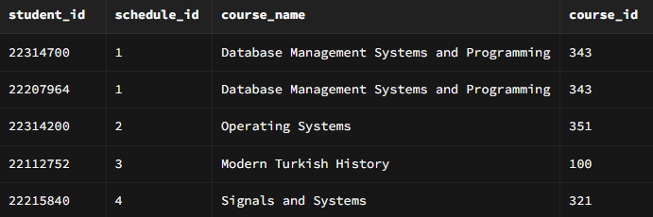
SQL
QUERIES
12

Slide 14
CMPE343
-
Project
-
Presentation
Thank You
“The database was implemented using Supabase.”
Github Project Page : https://github.com/22314700/CMPE343-University-Database-Project

